Slide 1
Applied Machine Learning
By Dr Ali Saeed

Slide 2
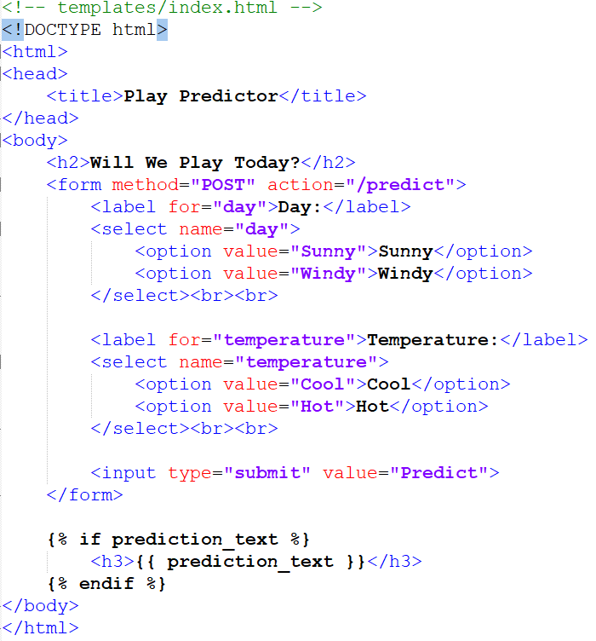
First create a template to show data

Slide 3
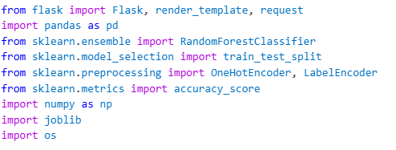
Import Libraries

Slide 4
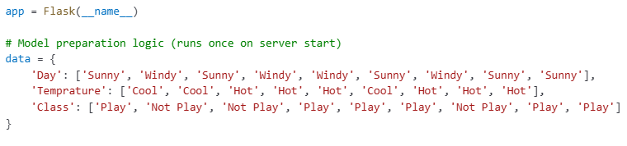
Flask App and Dataset

Slide 5
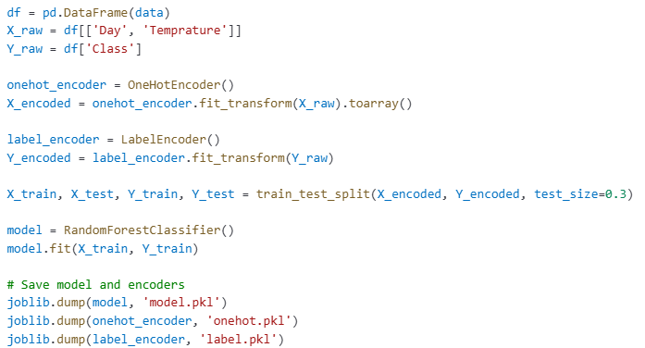
Train and dump model

Slide 6
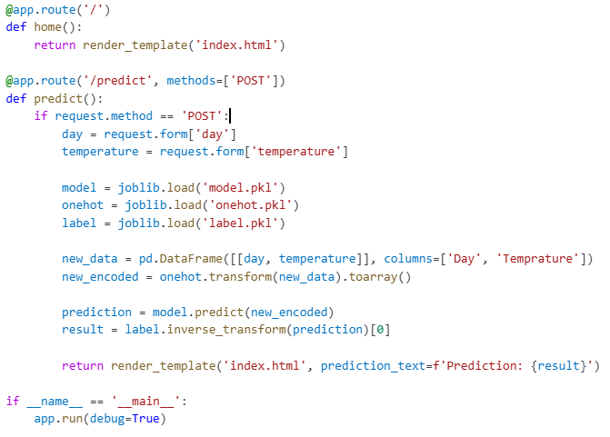
Flask Application

Slide 7
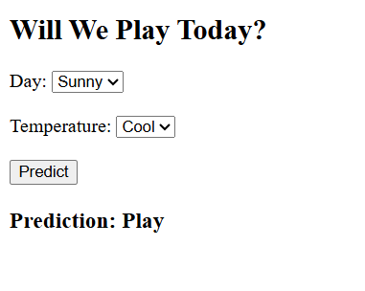
Output

